Slide 1
SIMC2.0 Oral Presentation
Dunman High School
Chee Justin Suwattana, Ethan Wang Jun Qi, Ryan Joo Rui An

Slide 2
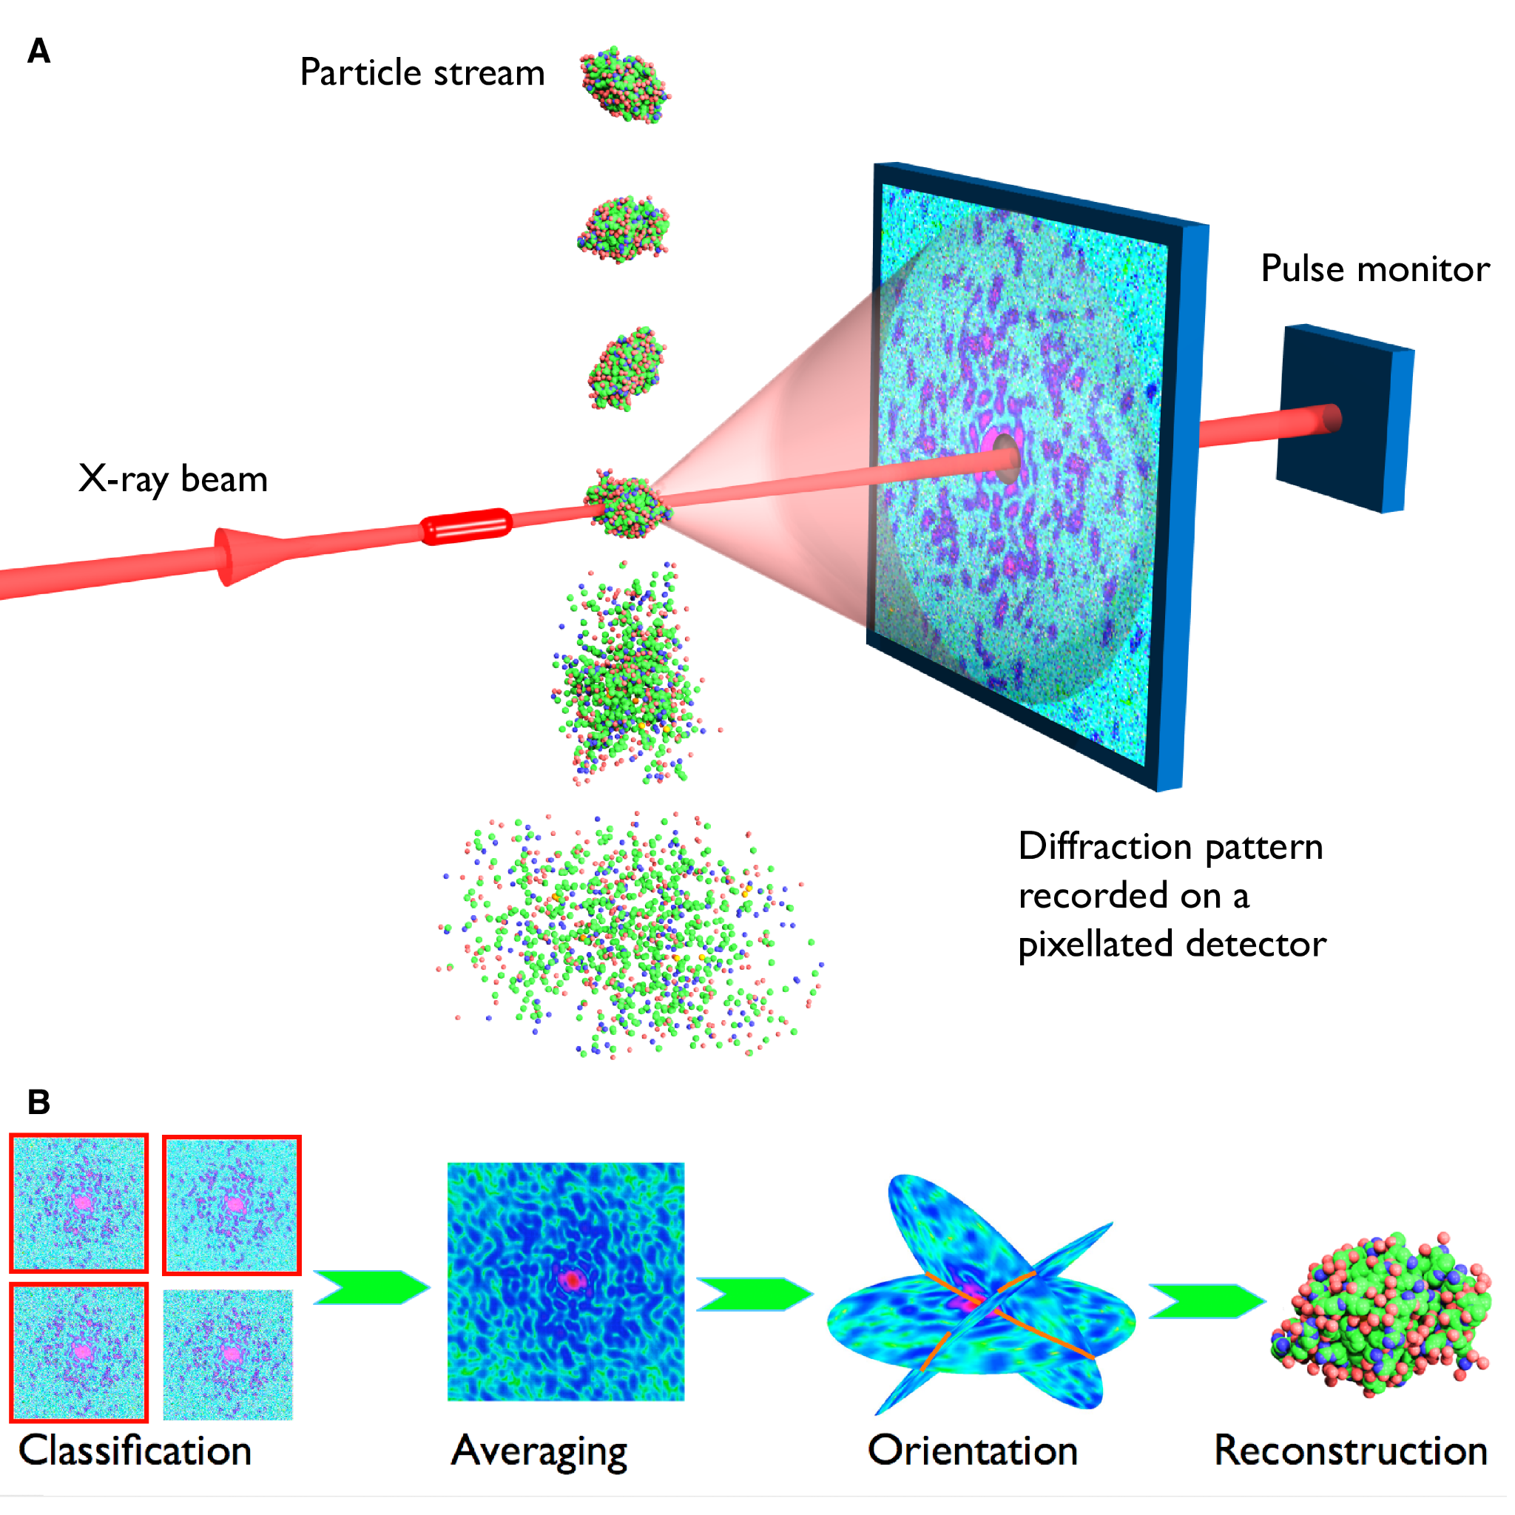
Introduction to the problem
Single-particle imaging (SPI) is a technique to determine the 3D structure of fragile biomolecules like proteins. It uses ultrafast X-ray pulses to capture a single image of a molecule at a time.
Credit: Coherent Imaging Division, Center for Free-Electron Laser Science (CFEL)

Slide 3
Introduction to the problem
The challenge is that the orientation of each molecule is unknown, making it difficult to reconstruct the 3D structure. Before solving the larger problem of SPI, in the first few tasks, we consider a simplified problem using 2D images with only 4 possible orientations.
Credit: Coherent Imaging Division, Center for Free-Electron Laser Science (CFEL)

Slide 4
Task 1: Classifying a few noiseless patterns
Problem statement:
We are given 25 patterns in numpy array task1, each containing 18x18 pixels. We are tasked to
plot the reference pattern (first pattern in task1) in its four clockwise rotations: 0, 90, 180 and 270 degrees,
list the number of patterns in each of the four orientations with respect to the first pattern.

Slide 5
Task 1(a): Classifying a few noiseless patterns
x=task1[0]
def rotate(x):
rotations = []
for i in range(4):
x2 = np.rot90(x,k=i,axes=(1,0))
rotations.append(x2)
rotations = np.array(rotations)
return rotations
Define a function which returns all 4 rotations of an input pattern

Slide 6
Task 1(a): Classifying a few noiseless patterns
f,ax=plt.subplots(1,4)
r=rotate(x)
for i in range(4):
ax[i].imshow(r[i])
ax[i].set_xticks([])
ax[i].set_yticks([])
Display all four rotations of the reference pattern (first pattern)

Slide 7
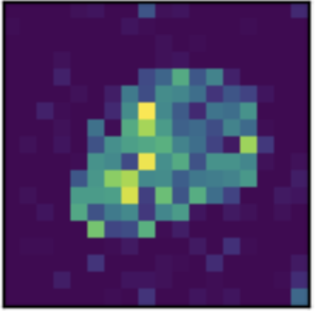
Task 1(a): Classifying a few noiseless patterns

Slide 8
Task 1(b): Classifying a few noiseless patterns
count = [0]*4
rots = rotate(x)
for i in range(25):
arr = task1[i]
for j in range(4):
if np.array_equal(rots[j], arr):
count[j]+=1
for i in range(4):
print(f"No of images rotated {i*90:3}
degrees:",count[i])
Count number of patterns in each orientation
Output number of patterns in each orientation

Slide 9
Task 1(b): Classifying a few noiseless patterns
Output:
No of images rotated 0 degrees: 6
No of images rotated 90 degrees: 10
No of images rotated 180 degrees: 6
No of images rotated 270 degrees: 3

Slide 10
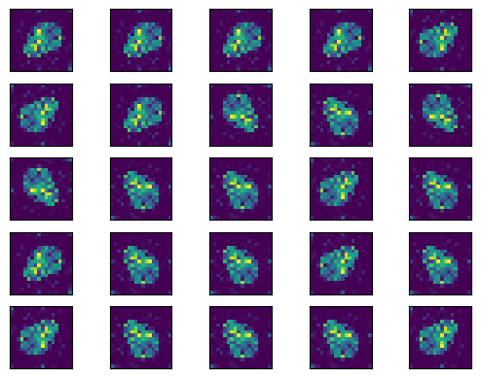
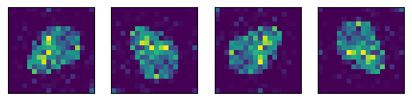
Task 1(b): Classifying a few noiseless patterns
x 6
x 10
x 6
x 3
Notes:
To verify answer, we displayed all 25 patterns of task1 using imshow() function, and subsequently counted the number of patterns for each orientation by visual inspection.

Slide 11
Task 2: Flattening 2D patterns into 1D representations
Problem statement:
We are given 100 patterns in numpy array task2. We are tasked to
render the 2D master image,
list the number of patterns in task2 array in each of the four orientations with respect to the first pattern.

Slide 12
Task 2(a): Flattening 2D patterns into 1D representations
task2_ref = task2[0].reshape(36,36)
plt.imshow(task2_ref)
plt.axis('off')
Reshape the flattened NumPy array to a 36x36 array

Slide 13
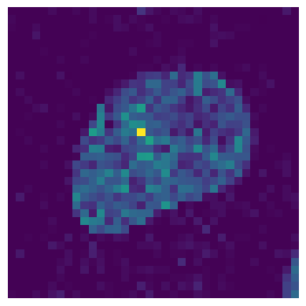
Task 2(a): Flattening 2D patterns into 1D representations

Slide 14
Task 2(b): Flattening 2D patterns into 1D representations
rots = rotate(task2_ref)
count = [0]*4
for i in range(100):
arr = task2[i].reshape(36,36)
for j in range(4):
if np.array_equal(rots[j], arr):
count[j]+=1
for i in range(4):
print(f"No of images rotated {i*90:3}
degrees:",count[i])
Generate four rotated versions of master image
Reshape all patterns to 36x36 arrays
Count number of patterns in each orientation
Output number of patterns in each orientation

Slide 15
Task 2(b): Flattening 2D patterns into 1D representations
Output:
No of images rotated 0 degrees: 22
No of images rotated 90 degrees: 32
No of images rotated 180 degrees: 21
No of images rotated 270 degrees: 25

Slide 16
Task 3: Scaling up to thousands of patterns
Problem statement:
We are given 1000 patterns in the numpy array task3 design matrix. We are tasked to
render the 2D master image used to create these patterns,
list the number of patterns in each of the four orientations with respect to the first pattern,
visually demonstrate that we have correctly classified the patterns by plotting both our unsorted and sorted design matrix.

Slide 17
Task 3(a): Scaling up to thousands of patterns
By observation, 1089 = 33², and we posit that the master image is a 33x33 pixel image.
task3_ref = task3[0].reshape(33,33)
plt.imshow(task3_ref)
plt.axis('off')
Reshape the NumPy array to a 33x33 array
Display the image

Slide 18
Task 3(a): Scaling up to thousands of patterns

Slide 19
Task 3(a): Scaling up to thousands of patterns

Slide 20
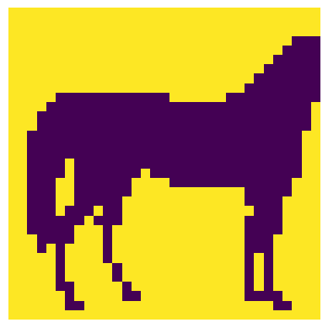
Task 3(a): Scaling up to thousands of patterns

Slide 21
Task 3(b): Scaling up to thousands of patterns
rots = rotate(task3_ref)
count = [0]*4
for i in range(1000):
arr = task3[i].reshape(33,33)
for j in range(4):
if np.array_equal(rots[j], arr):
count[j]+=1
for i in range(4):
print(f"No of images rotated {i*90:3}
degrees:",count[i])
Generate four rotated versions of master image
Reshape all patterns to 33x33 arrays
Count number of patterns in each orientation
Output number of patterns in each orientation

Slide 22
Task 3(b): Scaling up to thousands of patterns
Output:
No of images rotated 0 degrees: 254
No of images rotated 90 degrees: 236
No of images rotated 180 degrees: 250
No of images rotated 270 degrees: 260

Slide 23
Task 3(c): Scaling up to thousands of patterns
f,ax = plt.subplots(1,2)
ax[0].imshow(task3,aspect =33**2/1000,cmap =
'BuPu',extent=[0,1089,0,1000])
s = np.lexsort(task3.T)
sorted_array = task3[s]
ax[1].imshow(sorted_array,aspect=33**2/1000,
cmap = 'BuPu',extent=[0,1089,0,1000])
Display unsorted design matrix
Sort design matrix
Display sorted design matrix

Slide 24
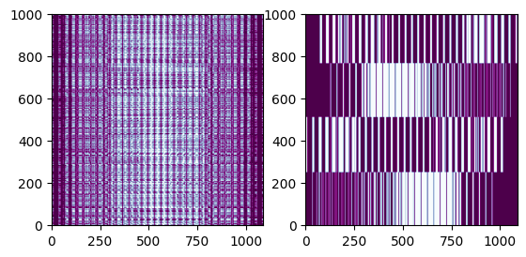
Task 3(c): Scaling up to thousands of patterns
Unsorted design matrix
Sorted design matrix

Slide 25
Task 4: Noisy patterns
Problem statement:
We are given design matrix task4. We are tasked to
determine the average 2D pattern’s total pixel value,
render the average (50x50 pixel) 2D pattern, assuming they were all the same orientation as the first pattern,
render each of the four orientation class averages as a 2D image.

Slide 26
Task 4(a): Noisy patterns
total=0
for i in range(1000):
total += sum(task4[i])
print("Average total pixel value:",
total/1000)
Sum up pixel values of all patterns,
then divide it by the number of patterns (1000)
Output:
Average total pixel value: 1251.047

Slide 27
Task 4(b): Noisy patterns
avg_img=np.mean(task4,axis=0).
reshape(50,50)
plt.imshow(avg_img)
plt.axis('off')
Reshape patterns from design matrix
At each pixel, take average of pixel values across all patterns
Display average 2D pattern

Slide 28
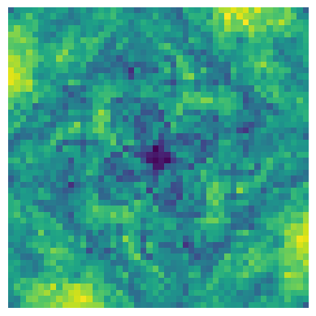
Task 4(b): Noisy patterns

Slide 29
Task 4(c): Noisy patterns
from sklearn.cluster import KMeans
n_clusters = 4
kmeans = KMeans(n_clusters=n_clusters, random_state=0,n_init=100).fit(task4)
cluster_labels = kmeans.labels_
f,ax = plt.subplots(1,4)
groups=[[],[],[],[]]
for i in range(1000):
group = cluster_labels[i]
groups[group].append(task4[i])
Cluster into 4 groups using KMeans clustering algorithm
Group patterns based on their assigned cluster label

Slide 30
Task 4(c): Noisy patterns
for i in range(4):
group = groups[i]
img = np.mean(np.array(group),
axis=0).reshape(50,50)
ax[i].imshow(img)
ax[i].set_xticks([])
ax[i].set_yticks([])
Take average of all patterns in each group to produce an image for every orientation class
Display all four images

Slide 31
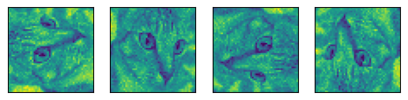
Task 4(c): Noisy patterns

Slide 32
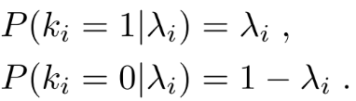
Task 5: Likelihood to succeed with noisy patterns
Prerequisite for master image reconstruction: determining individual pattern orientation even with the master image available. This is due to the noise model (β) significantly impacting the ability to determine a pattern's orientation.
The received photons per pixel has average value λ_{i}, and the likelihood of a pixel having k_{i} photons (either 1 or 0) is denoted:
Notes:
For Tasks 1 to 3, we dealt with patterns without noise, allowing us to do a direct comparison of patterns without having to cluster them.
For Task 4, there was noise in the patterns, so we could not do a direct comparison of patterns; in this case, we had to cluster them into 4 groups based on orientation class.
When there is more noise, our task is made more difficult, as noise would be treated as valid data, making any attempt at clustering by orientation futile.
Before even trying to reconstruct the master image, we should minimally be able to determine the orientation of a pattern given the master image; otherwise clustering won’t work.
In this task, we are to mathematically determine the likelihood of succeeding in reconstructing the master image given noisy patterns.

Slide 33
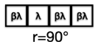
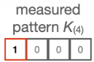
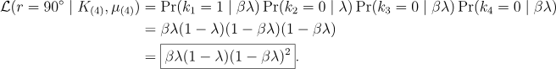
Task 5(a): Likelihood to succeed with noisy patterns
The likelihood that K₍₄₎ came from master image in orientation r = 90° is

Slide 34
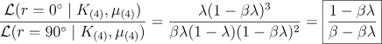
Task 5(b): Likelihood to succeed with noisy patterns
The ratio between likelihoods is given by

Slide 35
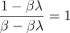

Task 5(c): Likelihood to succeed with noisy patterns
Equating the expression in 5(b) to 1 gives
on solving which yields
This implies that as the noise becomes increasingly similar to the actual pattern (likelihoods that measured pattern is aligned & misaligned to master image become equal), we are less able to determine which orientation is most likely.

Slide 36
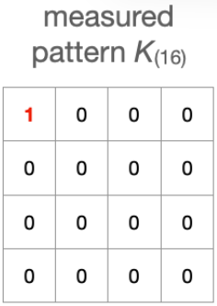
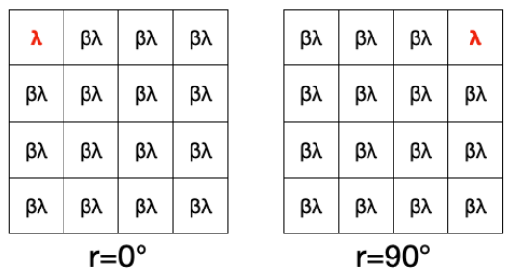
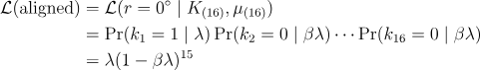
Task 5(d): Likelihood to succeed with noisy patterns

Slide 37

Task 5(d): Likelihood to succeed with noisy patterns

Slide 38
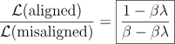
Task 5(d): Likelihood to succeed with noisy patterns
Therefore

Slide 39
Task 5(e): Likelihood to succeed with noisy patterns
Since it is given that λ_{i} can only take on two values, namely λ and βλ, we are essentially dealing with the following four cases:
Case A: k_{i} = 1 given μ_{i} = λ,
Case B: k_{i} = 0 given μ_{i} = λ,
Case C: k_{i} = 1 given μ_{i} = βλ,
Case D: k_{i} = 0 given μ_{i} = βλ.

Slide 40
Task 5(e): Likelihood to succeed with noisy patterns
Let J_{n} := {i ∈ ℤ⁺ : i ≤ n}. Let
A := {i ∈ J_{n} : k_{i} = 1 | λ},
B := {i ∈ J_{n} : k_{i} = 0 | λ},
C := {i ∈ J_{n} : k_{i} = 1 | βλ},
D := {i ∈ J_{n} : k_{i} = 0 | βλ}.

Slide 41
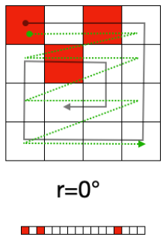
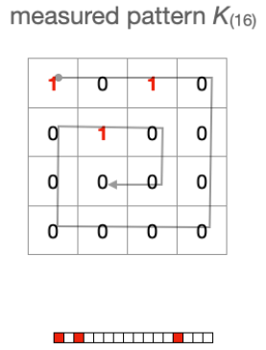
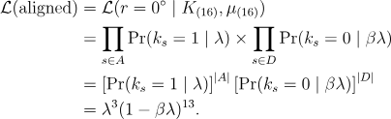
Task 5(e): Likelihood to succeed with noisy patterns
In the case where r = 0°,
A = {1, 3, 13}, B = ∅, C = ∅, D = (A ∪ B ∪ C)^{c} = A^{c}.
Thus |A| = 3, |B| = 0, |C| = 0, |D| = 13. Hence

Slide 42
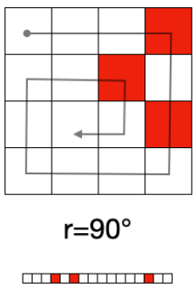
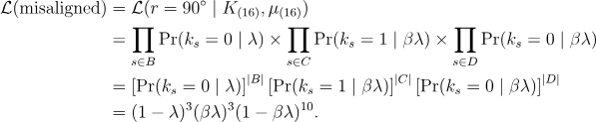
Task 5(e): Likelihood to succeed with noisy patterns
In the case where r = 90°,
A = ∅, B = {4, 6, 14}, C = {1, 3, 13}, D = (A ∪ B ∪ C)^{c}.
Thus |A| = 0, |B| = 3, |C| = 3, |D| = 10. Hence

Slide 43
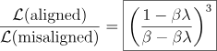
Task 5(e): Likelihood to succeed with noisy patterns
Therefore

Slide 44
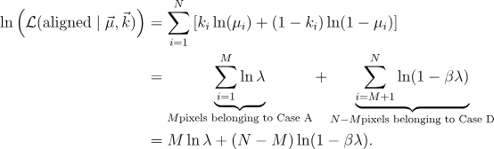
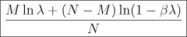
Task 5(f): Likelihood to succeed with noisy patterns
Using our notation, M pixels belong to Case A, and N – M pixels belong to Case D.
Hence the log-likelihood is given by
Therefore the average log-likelihood is given by

Slide 45
Task 5(f): Likelihood to succeed with noisy patterns
Our approach of simply taking an arithmetic mean turned out to be incorrect, as it is not identical to the graphs provided in the question paper.
An alternative approach: Under the assumption of a sufficiently large number of pixels N, the aligned log-likelihood function can be approximated by a normal distribution due to the Central Limit Theorem:
~ N(μ, σ²/N)
where μ and σ², which are to be determined, vary with λ and β.
This allows us to calculate the average log-likelihood, which is simply the expected value of the normal distribution.

Slide 46
Task 6: Scaling up with sparse data format
Problem statement:
We are given design matrix task6, which contains 65,535 patterns, each being a flattened 25x25 pixel image. We are tasked to
determine the average pattern’s total pixel value,
render the average (25x25 pixel) 2D pattern, assuming they were all the same orientation as the first pattern,
render each of the four orientation class averages as a 2D image.

Slide 47
Task 6(a): Scaling up with sparse data format
print("Average total pixel value: ",
task6a.shape[0]/65535)
Divide length of vector a (which indicates the total number of 1s in all the patterns) by the number of patterns (65535)
Output:
Average total pixel value: 23.745372701609828

Slide 48
Task 6(b): Scaling up with sparse data format
img=np.zeros((25,25))
for i in range(task6a.shape[0]):
x=task6b[i]
img[x//25,x%25]+=1
plt.imshow(img/65535)
plt.axis('off')
Map the values in vectors b to their respective pixel index to produce a 25x25 matrix that is the sum of all pixels at each position
Take average of every pixel to produce the average pattern

Slide 49
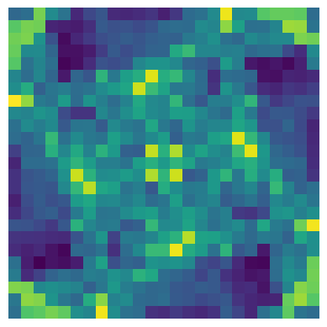
Task 6(b): Scaling up with sparse data format

Slide 50
Task 6(c): Scaling up with sparse data format
images=np.zeros((65535,625))
for i in range(task6a.shape[0]):
x,y=task6a[i],task6b[i]
images[x,y]=1
n_clusters = 4
kmeans = KMeans(n_clusters=n_clusters,
random_state=0,n_init=100).fit(images)
cluster_labels = kmeans.labels_
Form design matrix by mapping the values in vectors a and b to their respective pattern and position
Cluster patterns into 4 groups based on their orientation class using KMeans algorithm

Slide 51
Task 6(c): Scaling up with sparse data format
f,ax = plt.subplots(1,4)
groups=[[],[],[],[]]
for i in range(65535):
group = cluster_labels[i]
groups[group].append(images[i])
for i in range(4):
group = groups[i]
img = np.mean(np.array(group),
axis=0).reshape(25,25)
ax[i].imshow(img)
ax[i].set_xticks([])
ax[i].set_yticks([])
Assign images to their cluster group based on their labels
Take the average of pixels of each pattern in the orientation class, produce an image for each group

Slide 52
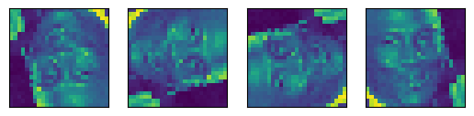
Task 6(c): Scaling up with sparse data format

Slide 53
Task 7: Sharing data amongst orientations
Problem statement:
We are given design matrix task7, which contains 100,000 patterns, each being a flattened 25x25 pixel image. We are tasked to
render our reconstruction of the 2D master image.

Slide 54
Task 7(a): Sharing data amongst orientations
images=np.zeros((100000,625))
for i in range(task7a.shape[0]):
x,y=task7a[i],task7b[i]
images[x,y]=1
Use vectors provided to create design matrix of 100,000 flattened 25x25 images
Then use KMeans algorithm to cluster the datasets into 4 groups similar to before

Slide 55
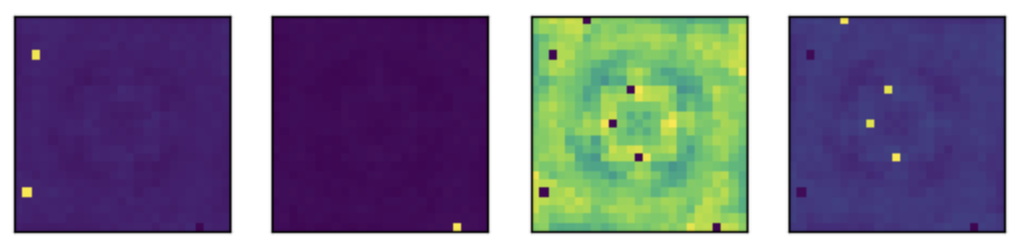
Task 7(a): Sharing data amongst orientations
Notes:
However, this approach did not yield any substantial results as there was too much noise in the images and the clustering algorithm was unable to accurately cluster the images by their orientation class.

Slide 56
Task 7(a): Sharing data amongst orientations
new_images=np.zeros((400000,625))
for i in range(0,400000,4):
img = images[i//4].reshape(25,25)
rots = rotate(img)
new_images[i]=rots[0].flatten()
new_images[i+1]=rots[1].flatten()
new_images[i+2]=rots[2].flatten()
new_images[i+3]=rots[3].flatten()
images = new_images
Make our images dataset 4 times as large by adding all 4 rotations of each pattern
For each orientation, there are now 4 times as many patterns. We believe this approach averages noise out across more patterns.

Slide 57
Task 7(a): Sharing data amongst orientations
n_clusters = 4
kmeans = KMeans(n_clusters=n_clusters, random_state=0, n_init=10,init='k-means++').fit(images)
cluster_labels = kmeans.labels_
f,ax = plt.subplots(1,n_clusters)
new_groups=[]
for _ in range(n_clusters):
new_groups.append([])
for i in range(images.shape[0]):
group = cluster_labels[i]
new_groups[group].append(images[i])
Another round of KMeans clustering
Notes:
Upon experimentation, we discovered that when setting n_init as 100, the results were not much different than before. Hence we set n_init as 10.

Slide 58
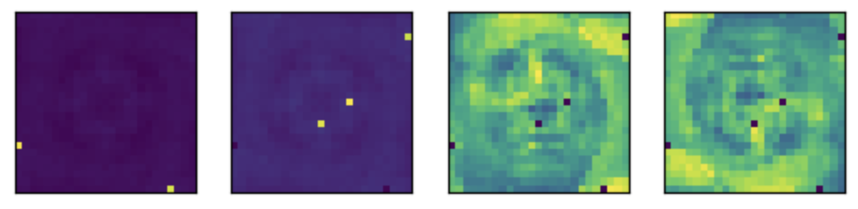
Task 7(a): Sharing data amongst orientations
Notes:
The algorithm managed to clearly split the data into two groups, both appearing to be rotations of the master image.

Slide 59
Task 7(a): Sharing data amongst orientations
temp = np.zeros((len(new_groups[3]),625))
for i in range(len(new_groups[3])):
img = new_groups[3][i].reshape(25,25)
img = np.rot90(img,k=2,axes=(1,0))
temp[i]=img.flatten()
images = np.concatenate((temp, new_groups[2]), axis=0)
plt.imshow(np.mean(images,axis=0).reshape(25,25))
plt.axis('off')
Rotate patterns from group 3
Concatenate them to patterns from group 2 to create one group of patterns that are mostly in the same orientation, making it easier to denoise

Slide 60
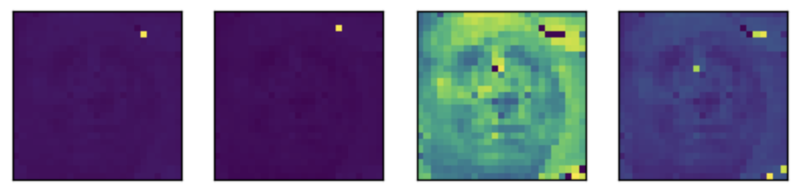
Task 7(a): Sharing data amongst orientations
Notes:
The master image is seen in the third image from the left, while the rest of the images seem to be noise filtered out from the dataset. From visual inspection, the master image resembles the face of a person whose identity cannot be immediately determined.

Slide 61
Thank You!

